Slide 1
Introduction to Contour, A High Performance Multitenant Ingress Controller for Kubernetes
Michael Michael
Nick Young

Slide 2


Who Are We?
Contour Maintainer & Technical Lead
Staff Engineer, VMware
@youngnick on K8s Slack
Contour Maintainer & Product Lead
Director of PM, VMware
@m2 on K8s Slack

Slide 3

Contour- projectcontour.io
Contour is an open source Kubernetes ingress controller providing a control plane for the Envoy edge and service proxy.​ Contour supports dynamic configuration updates and multi-team ingress delegation out of the box while maintaining a lightweight profile
Started in September 2017 at Heptio
Released v1.0 in November 2019
Donated to the CNCF at Incubation level in July 2020
Mission - To be the most secure, performant, scalable, and available ingress controller for Kubernetes

Slide 4
Contour Features
Advanced Ingress
CNCF Ecosystem Good Citizen
Safely use multi-team ingress in Kubernetes
New concepts like inclusion and conditions
Dynamic Reconfiguration
Mirror service capabilities
Request and response header manipulation
Host rewriting to external domains
Prefix rewrite support
Built for Kubernetes
Envoy Inside
Security
Secure Ingress Delegation

Slide 5
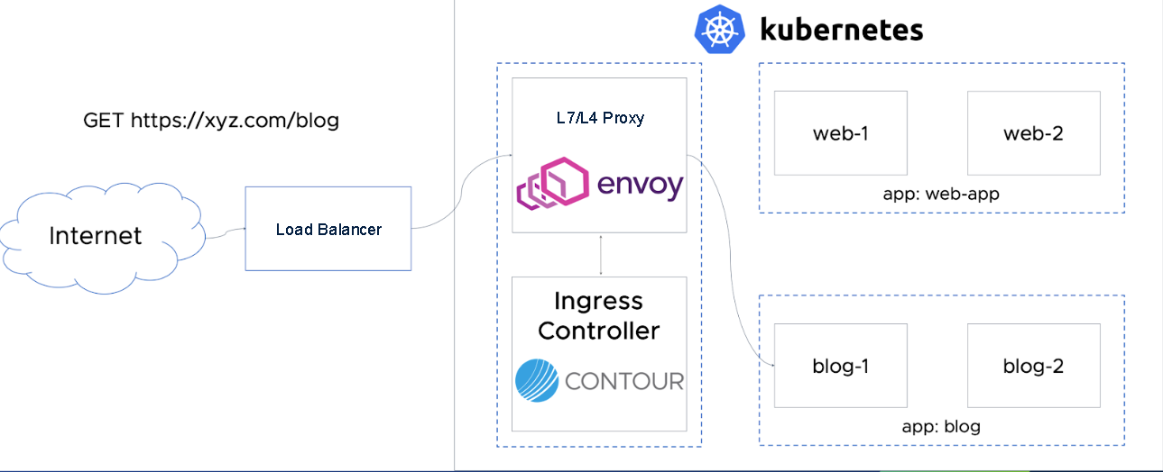
Architecture

Slide 6
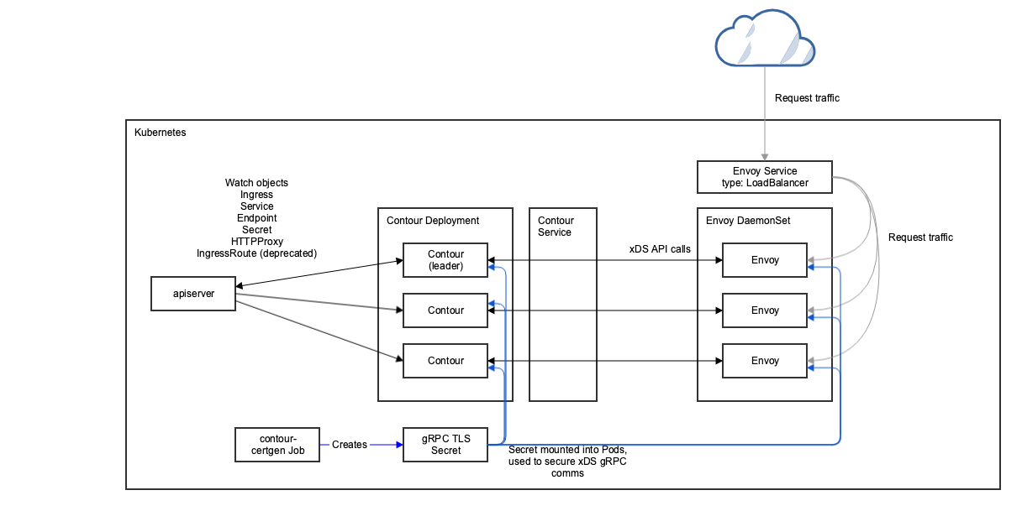
A Contour Deployment in K8s

Slide 7
What’s New
We ship on a monthly cadence
We address CVEs (internal and Envoy’s) immediately
Client Certificate authentication in HTTPProxy objects
Hot-Reload Certificates
Envoy Shutdown Manager
Deprecated & Removed IngressRoute

Slide 8
Roadmap
Closely align with upstream Service APIs effort
Expose more Envoy configuration knobs
Authentication support for services
Rate limiting
Deployment enhancements
Support Access Log Service
For more details, visit our public Roadmap

Slide 9






Contour Community
Slack.k8s.io
projectcontour.io
#contour
cncf-contour-users@lists.cncf.io
2.4k
GitHub Stars
100+ Contributors
350+ Forks
5 Maintainers
50 Releases
100+
Contributing
Companies
@projectcontour
https://github.com/projectcontour
650
Slack members
13 Blogs
5 KubeCon talks
675
Twitter followers
https://www.youtube.com/playlist?list=PL7bmigfV0EqTBsPrnCkzhu0R4SAWnBjLj

Slide 10
Demo!

